Slide 1
illumination
Sprint 2
By Team 1 Tech Titans

Slide 2
Agenda
Team Member Roles and Responsibilities
Improvements made from Professor Feedback
Project Description
Team Working Agreement
Personas (at least 3)
MVP (Minimum Viable Product)
Technologies
Algorithms
Diagrams
Product Backlog
Sprint 2 Backlog
Metrics
Retrospective
Sprint 3 Plan
Project Demo - Sprint 2
GitHub Link
Live Application Demo

Slide 3
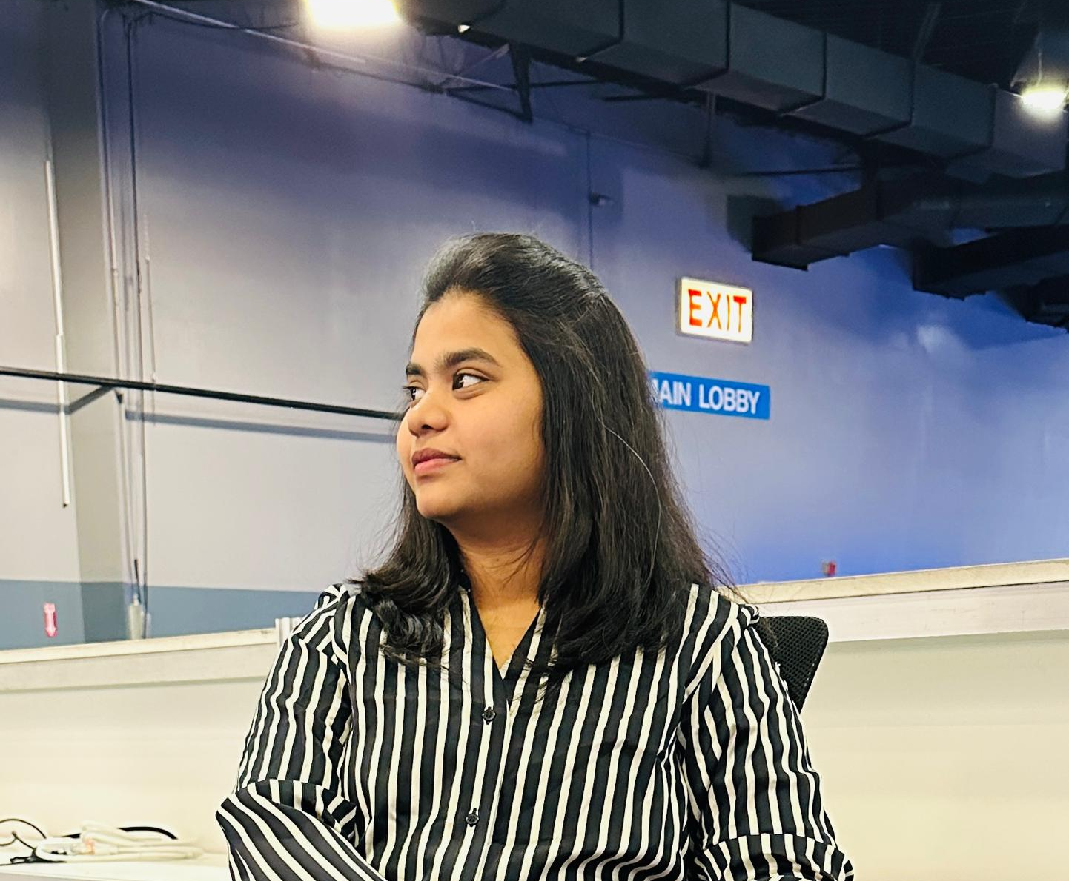


Team Members
Anuhya Marapalli
Rithin Guptha Bajuri
Snehalatha Boothpur
Scrum Master / Developer
Developer
Designer / Developer

Slide 4


Team Members
Harshitha Rangaraju
Srinivas Reddy Bapathu
Team Leader and Developer
Developer and Tester

Slide 5
Improvements
Creating Proper Burndown Chart
Change in the context diagram

Slide 6
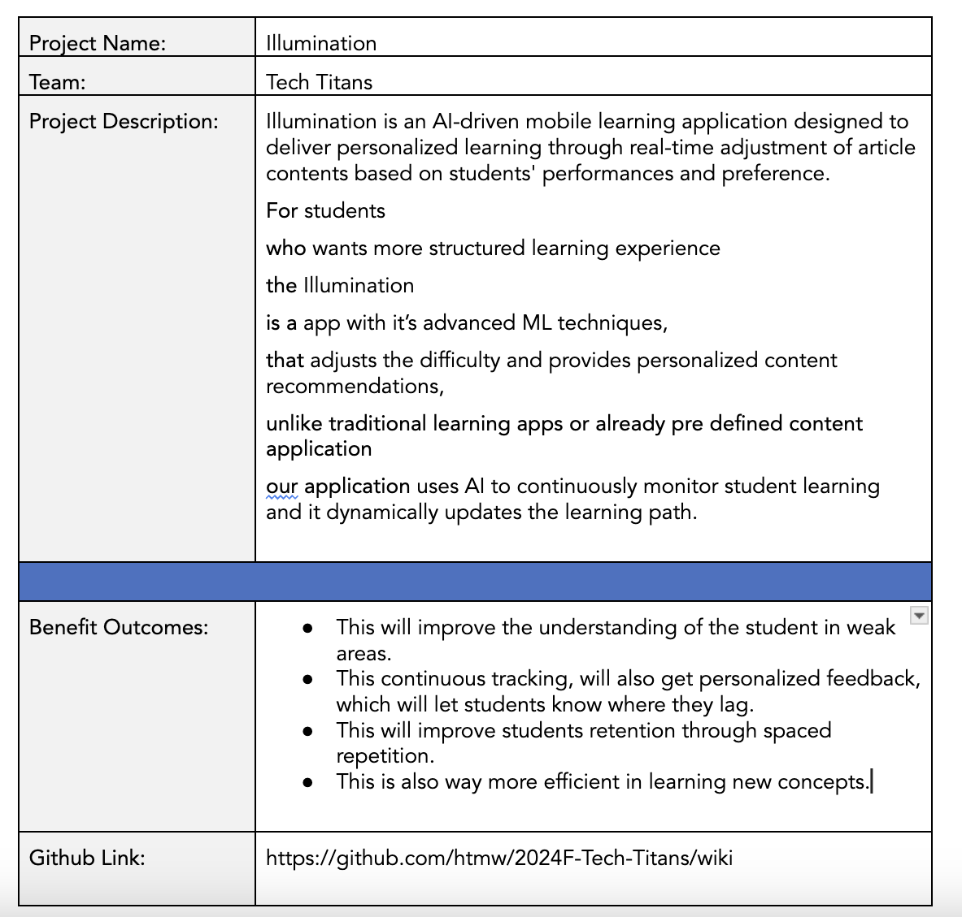
Project Description
BRAND NAME

Slide 7
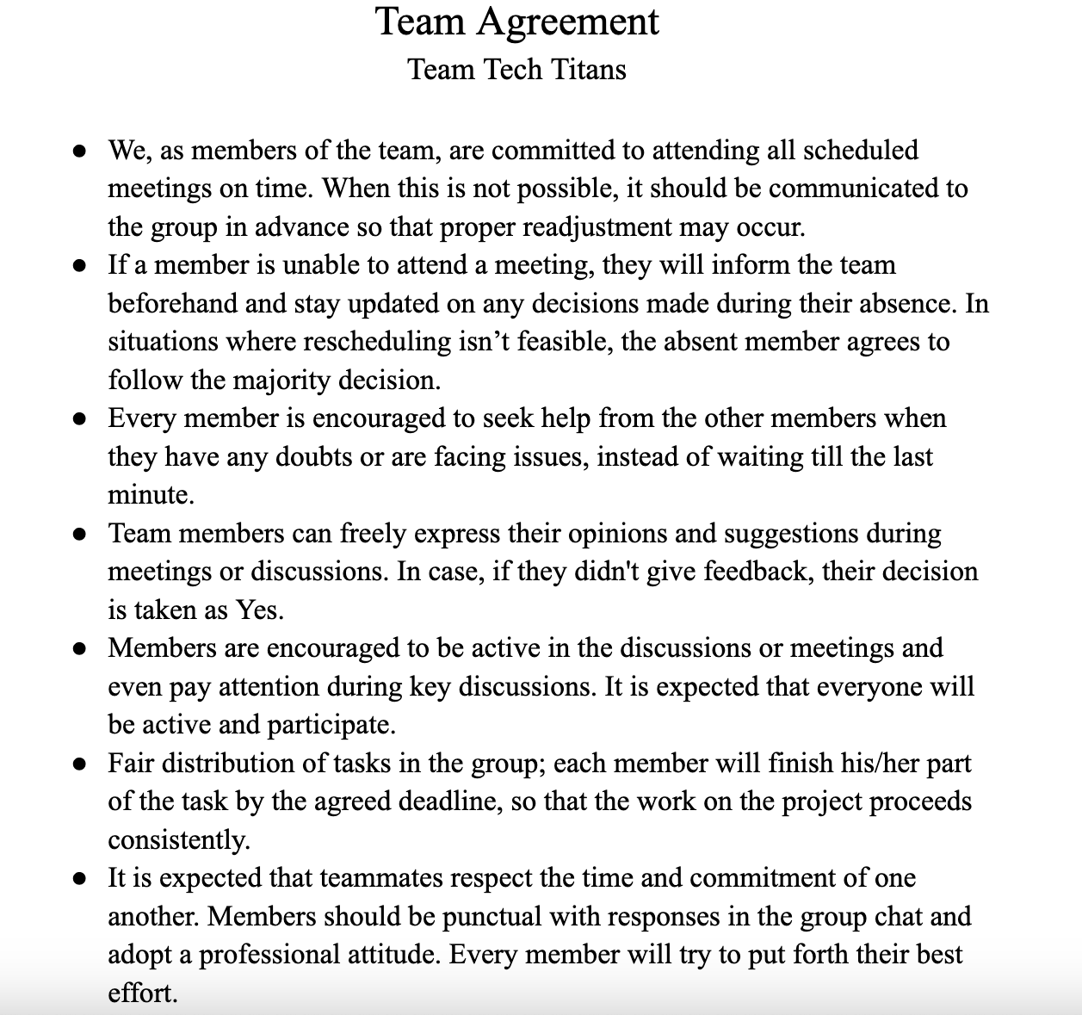
Team Agreement

Slide 8

Ankit, 17 year old
Ankit is a high schooler who is preparing for IIT JEE exams where is he good at Mathematics and Chemistry but he struggles in Physics, even though he attends extra classes, but he never excels it. So, he feels like he personalized study material to improve his weak areas.
Goals:
Have good grasp on difficult physics topics.
Have access to personalized materials on complex topics or topics where he is weak at.
Able to balance school, extra classes and self study.
Challenges
There is a lot of content in online or in books but unable to find proper content for his weakness topics.
Searching for proper material is time taking.
Unable to identify the weak topics.

Slide 9

Rajat, 28 year old
Rajat is CA (Chartered Accountant) aspirant from Mumbai, but he is also working full time in financial firm, which causes him have less time to study. He finds financial reporting and taxation difficult and even struggling to focus because of tight schedule.
Goals:
Improve the understanding of the complex topics.
Able to access the targetted material on the topics which he finds difficult.
Able to balance both work and preparation.
Challenges:
Its difficult to manage both work life and student life which leading him not to study well.
Time consuming on finding the concepts he is weak at.
Struggling to study all because of broad topics in CA.

Slide 10

Kavya, 21 year old
Kavya is engineering student, as she is near her job trails and she is interested in Machine Learning and GenAI, she want to study them and learn them, but she have no idea on machine learning. When she searching of google for roadmap, all those roadmap doesn't suit her well which causes her to distract.
Goals
Master all Machine learning and deep learning concepts.
Able to read fine quality materials which simplify the complex concepts into simple once.
Challenges
There are alot of materials on it which causes to read alot of materials of same topics to understand them.
Facing difficulties in retaining the concepts.
Unable to keep up with the latest trends on ML.

Slide 11
MVP
Subject Selection: Choose subjects to access articles.
Article Reading: Browse and read subject-specific articles.
Mark Articles for Later: Save articles for future review.
Search Functionality: Search articles within a subject.
Personalized Recommendations: Get suggestions based on performance.

Slide 12
Technologies
01.
02.
03.
Backend
Frontend
Tools
fastAPI
Node JS
Mongodb
AWS
Pytorch
React Native
Github
Postman
Google Colab
VSCode

Slide 13





Backend
Here FastAPI is primarily used for machine learning backend tasks where as Node JS is primarily deals with Client Side code. MongoDB for Storing the data. AWS for hosting and even for storing the objective Data. Pytorch for Machine learning

Slide 14

2. Frontend
React Native is used for building cross platform mobile application.

Slide 15




3. Tools
Github is where code and even the documents are shared. Postman is for API Testing. Google Colab for training the Machine Learning Model. VSCode is used for writing the code

Slide 16
Algorithms
Reinforcement Learning
Reinforcement Learning (RL) is a machine learning paradigm where an agent learns by interacting with an environment and receiving rewards for actions. In adaptive learning, RL is used to dynamically adjust content difficulty based on student responses, maximizing engagement and learning efficiency over time.
Word2Vec
Word2Vec is a deep learning-based model that transforms words into continuous vector representations, capturing semantic relationships between words. In content-based filtering, it is used to convert textual content (article text) into vectors, allowing us to measure similarity between content items. Similar vectors imply similar content, enabling personalized recommendations.

Slide 17
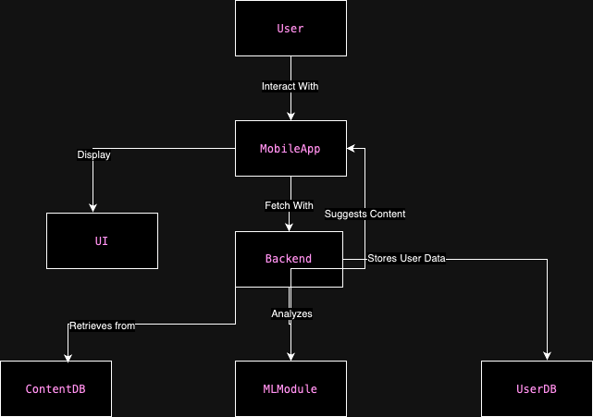
Architecture Diagram

Slide 18
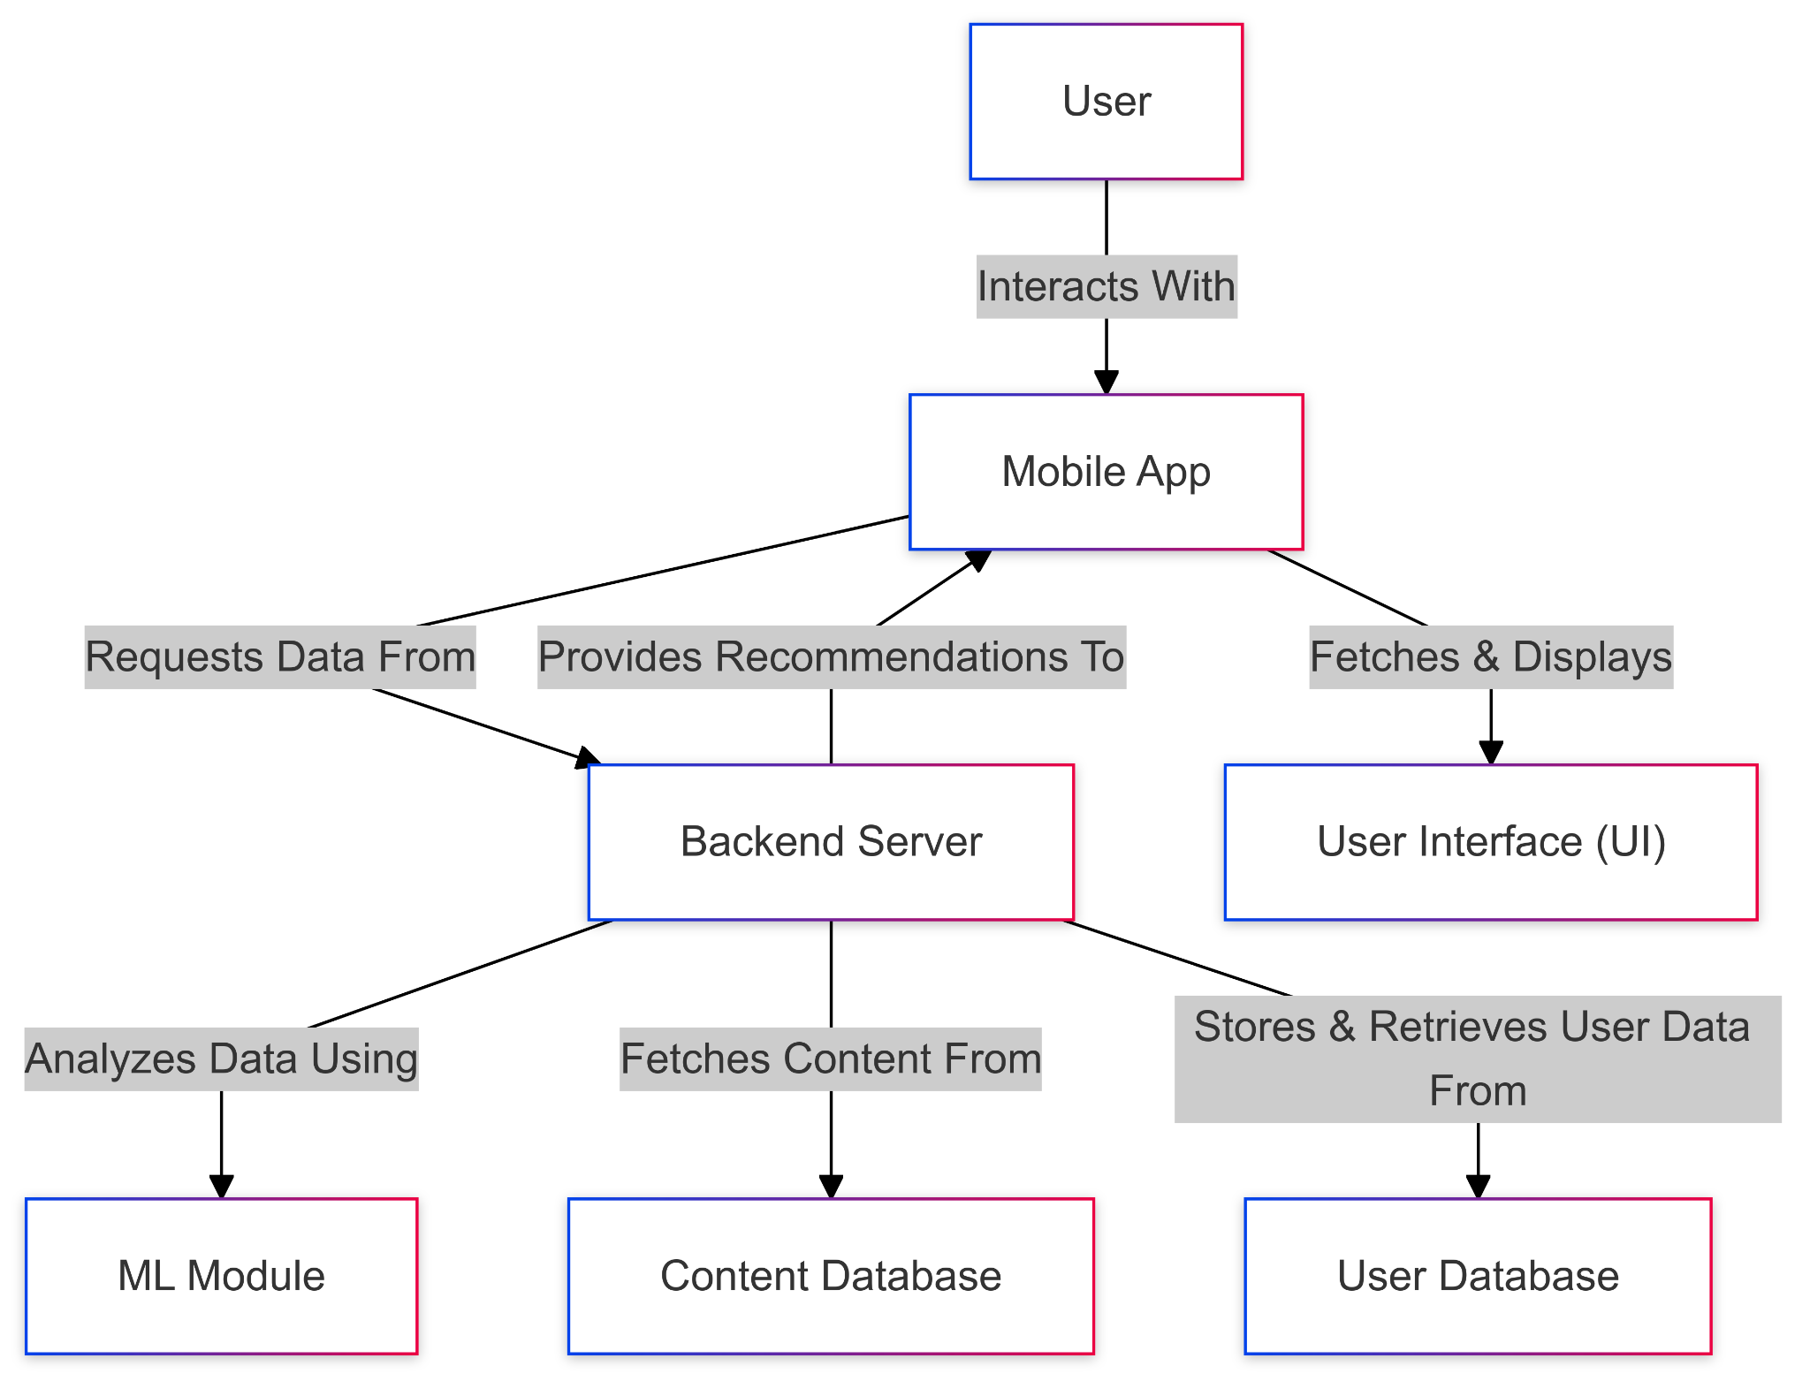
Context Diagram

Slide 19
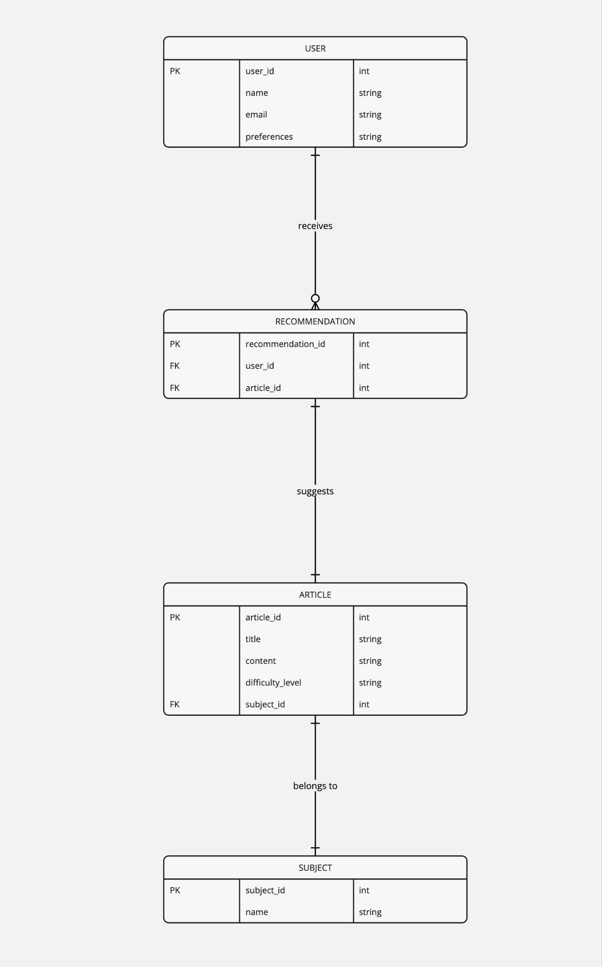
ER Diagram

Slide 20
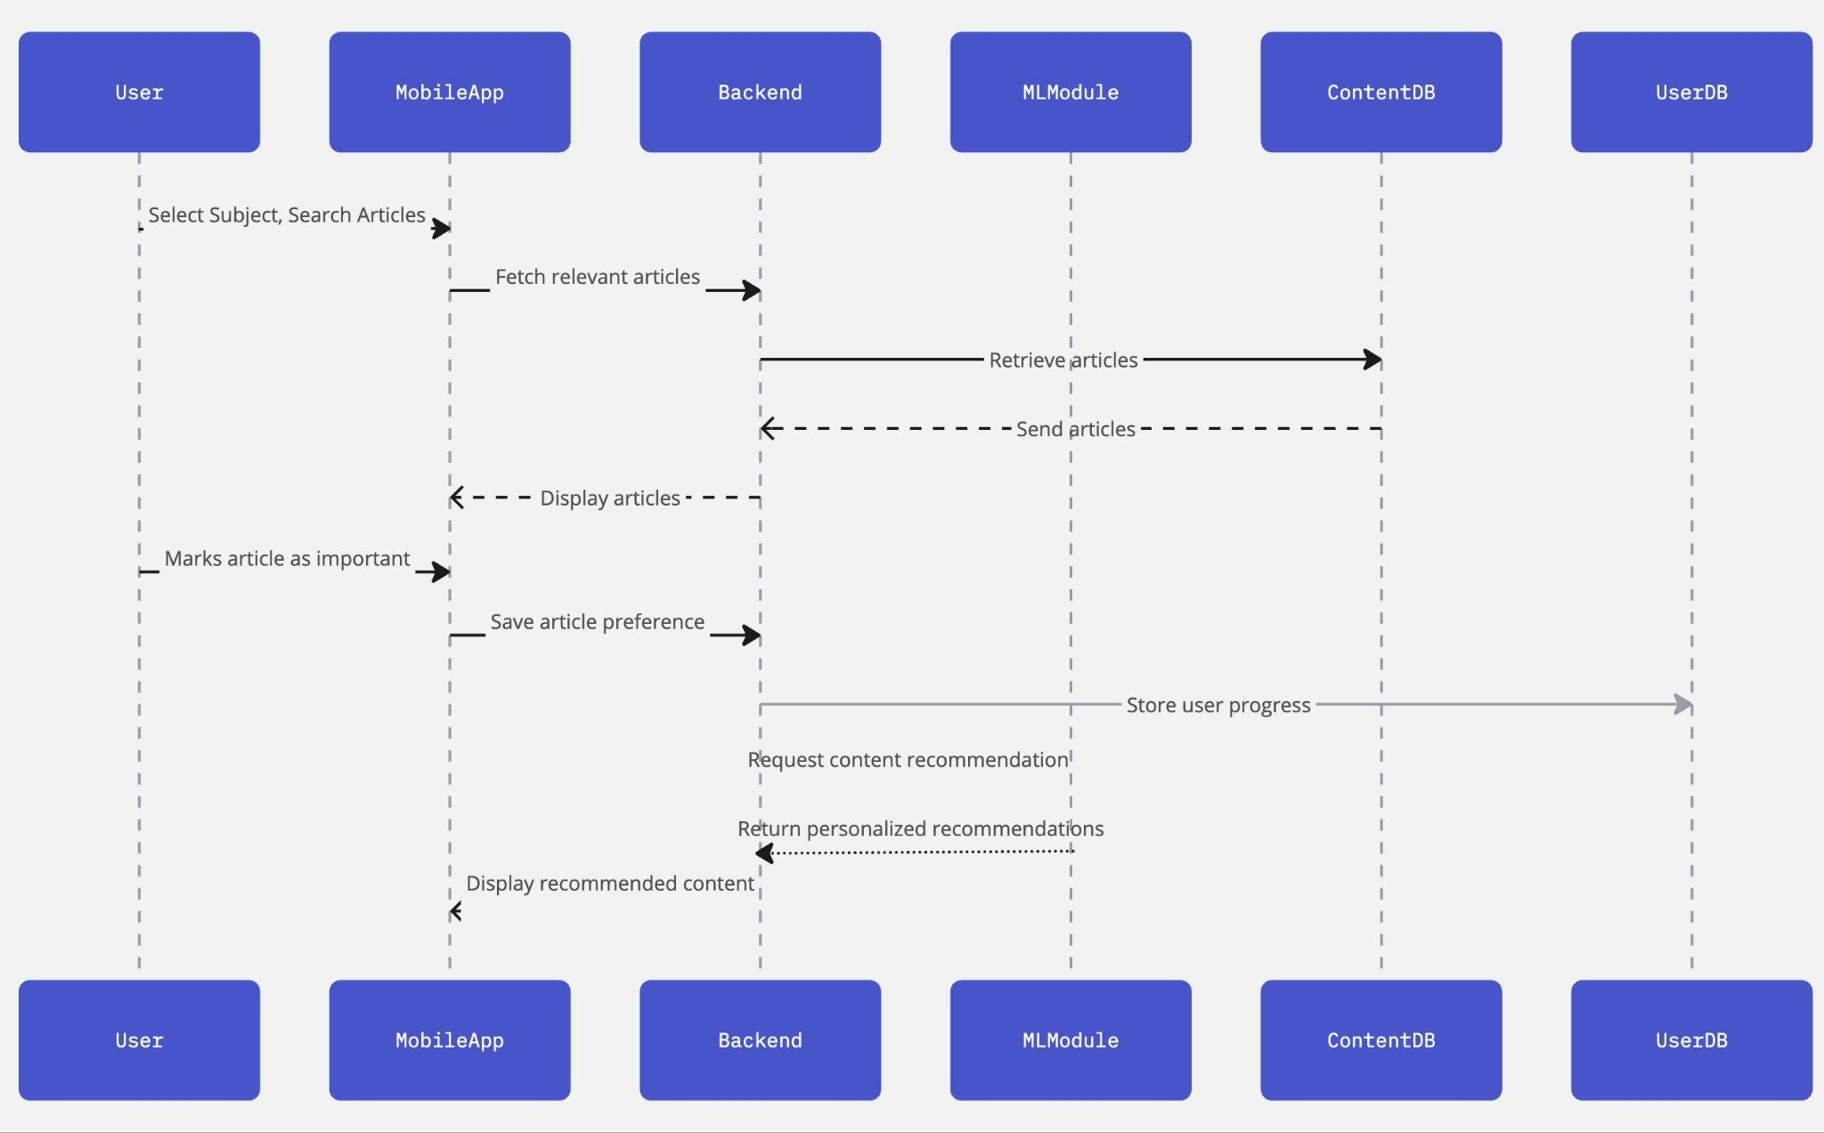
Sequence Diagram

Slide 21
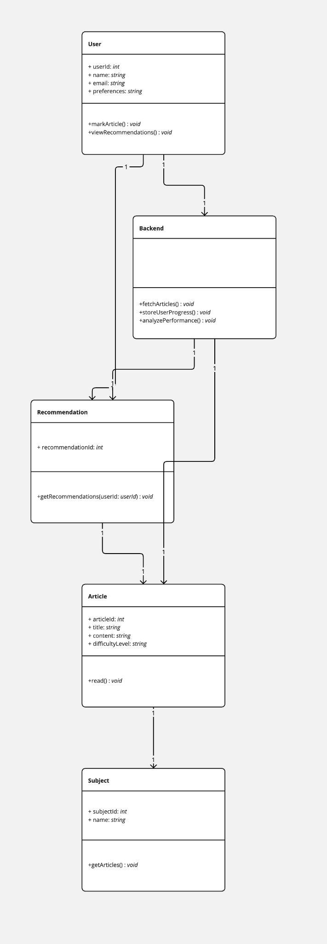
Class Diagram

Slide 22
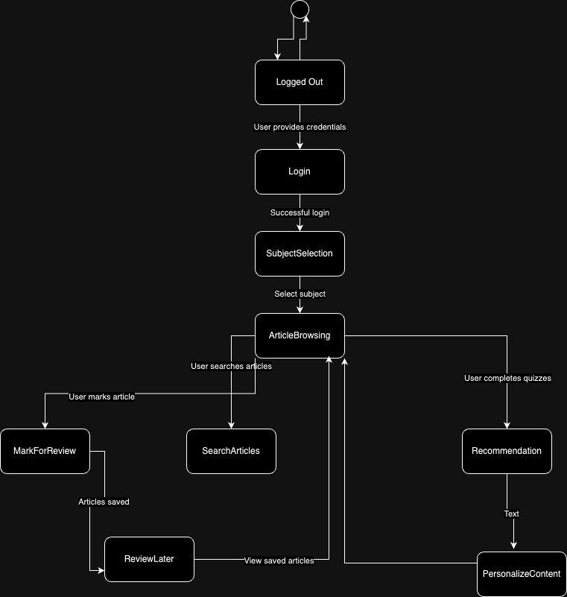
State Diagram

Slide 23
Sprint 1 Recap
Subject Selection and Article Reading Features: Enabled selecting subjects and reading relevant articles smoothly.
Mark, Search, and Navigate Articles: Allowed marking, searching, and seamless navigation between articles.
Basic UI and Content Management Setup: Developed clean interface and efficient content storage system.

Slide 24
Product Backlog
# | Sprint | Feature | User Story/Technical Story | Acceptance Criteria
1 | Sprint 1 | Subject Selection | User Story 1: As a student, I want to select a subject so I can access relevant learning content. | Users can select from multiple subjects (e.g., Math, Science, History). Selected subjects load relevant articles.
2 | Sprint 1 | Article Reading | User Story 2: As a student, I want to browse and read articles related to the subject I selected. | Articles display in a clean, mobile-friendly interface. Users can scroll and navigate within articles seamlessly.
3 | Sprint 1 | Mark Articles for Later | User Story 3: As a student, I want to mark articles as "difficult" or "important" for later review. | Users can mark articles as "difficult" or "important". Marked articles appear in a "Review Later" section.
4 | Sprint 1 | Article Search | User Story 4: As a student, I want to search for specific articles within a subject. | Users can search for articles by keywords within a subject. Search results are displayed based on relevance.
5 | Sprint 1 | Article Navigation | User Story 5: As a student, I want to navigate between articles within the same subject. | Users can use "next" and "previous" buttons or a navigation bar to move between articles. Ensure smooth transitions.

Slide 25
Product Backlog
# | Sprint | Feature | User Story/Technical Story | Acceptance Criteria
6 | Sprint 1 | Basic UI for Articles | Technical Story 1: Set up basic UI/UX for browsing and reading articles. | Clean, intuitive design for subject selection and article reading. Ensure mobile responsiveness.
7 | Sprint 1 | Content Management System | Technical Story 2: Implement content management system for loading articles by subject. | Articles are stored and categorized by subject. Efficient retrieval of content from a backend system.
8 | Sprint 1 | Mark and Save Articles | Technical Story 3: Add functionality for marking and saving articles for later review. | Users can save marked articles to a "Review Later" list. Data is persisted across sessions.
9 | Sprint 1 | Search Functionality | Technical Story 4: Implement article search functionality. | Enable a search feature within each subject. Search results are displayed quickly and accurately.
10 | Sprint 2 | Personalized Recommendations | User Story 6: As a student, I want personalized content recommendations based on my performance so I can improve weak areas. | The system provides content recommendations based on quiz performance and article difficulty. Users are directed to articles covering weak areas.

Slide 26
Product Backlog
# | Sprint | Feature | User Story/Technical Story | Acceptance Criteria
11 | Sprint 2 | Spaced Repetition | User Story 7: As a student, I want the app to implement spaced repetition to reinforce key concepts over time. | The app identifies and schedules spaced repetition for topics users struggle with. Users are prompted to revisit articles or take quizzes at optimal intervals.
12 | Sprint 2 | Performance Dashboard | User Story 8: As a student, I want to track my progress in a performance dashboard. | The dashboard shows quiz scores, articles read, and time spent on each subject. Users can see areas of strength and weakness visually.
13 | Sprint 2 | Targeted Feedback on Quizzes | User Story 9: As a student, I want to receive targeted feedback after quizzes so I can understand my mistakes. | Detailed feedback is provided for each quiz question. Feedback explains why certain answers are correct/incorrect.
14 | Sprint 2 | Dynamic Content Adjustment | User Story 10: As a student, I want the app to dynamically adjust content difficulty based on my performance. | The difficulty of content increases if the user performs well. If a student struggles, simpler articles or review content is recommended.
15 | Sprint 2 | Basic Machine Learning for Recommendations | Technical Story 5: Implement a basic machine learning model for personalized content recommendations. | The model analyzes quiz performance and article difficulty to recommend personalized learning paths. Adjustments are made based on user progress.

Slide 27
Product Backlog
# | Sprint | Feature | User Story/Technical Story | Acceptance Criteria
16 | Sprint 2 | Spaced Repetition Algorithm | Technical Story 6: Integrate spaced repetition algorithm to reinforce key concepts. | Use spaced repetition techniques to schedule when users should revisit difficult topics. Ensure the system prompts users at the right time for maximum retention.
17 | Sprint 2 | Performance Dashboard Development | Technical Story 7: Build a performance dashboard to visualize progress. | The dashboard shows quiz results, time spent, and subject mastery. Visual charts display performance trends.
18 | Sprint 2 | Quiz Feedback Mechanism | Technical Story 8: Provide detailed quiz feedback for user learning. | Implement feedback mechanisms to explain quiz results. Feedback is both constructive and designed to reinforce learning.
19 | Sprint 3 | User Accounts & Syncing | User Story 11: As a student, I want to create an account and log in so I can save my progress and preferences across devices. | Users can create accounts with email/password. User progress, preferences, and recommendations are saved and synced across devices.
20 | Sprint 3 | Adaptive Study Paths | User Story 12: As a student, I want my study path to adapt based on my long-term learning trends and preferences. | The app uses ML to analyze long-term trends and dynamically adjust learning paths. Preferences are stored, and content is adapted based on user learning styles.

Slide 28
Product Backlog
# | Sprint | Feature | User Story/Technical Story | Acceptance Criteria
21 | Sprint 3 | Reminders for Spaced Repetition & Recommendations | User Story 13: As a student, I want to receive reminders for spaced repetition and personalized study recommendations. | Notifications prompt users for spaced repetition and recommended articles. Reminders are personalized based on past performance and study schedules.
22 | Sprint 3 | Learning History | User Story 14: As a student, I want to view my learning history so I can review previously studied articles and performance. | Users can access their study history, including completed articles and quizzes. History includes quiz scores, article read dates, and time spent.
23 | Sprint 3 | Adaptive Feedback Based on Trends | User Story 15: As a student, I want to receive adaptive feedback based on my performance trends over time so I can improve continuously. | The app provides adaptive feedback based on overall performance and trends. Feedback is more tailored as the system learns from the user’s progress and actions.
24 | Sprint 3 | User Authentication | Technical Story 9: Implement user authentication and profile management. | Secure user authentication system with account creation, login, and password recovery. Ensure user progress and data are stored across sessions.
25 | Sprint 3 | Refined ML for Long-Term Learning | Technical Story 10: Refine the machine learning model for adaptive feedback based on long-term learning trends. | The ML model adapts based on user learning patterns and feedback. Ensure the model evolves based on long-term trends and personalized learning data.

Slide 29
Product Backlog
# | Sprint | Feature | User Story/Technical Story | Acceptance Criteria
26 | Sprint 3 | Reminders & Notifications | Technical Story 11: Implement reminders and notifications for spaced repetition and content recommendations. | Notifications are sent based on spaced repetition schedules and content recommendations. Ensure reminders are relevant and personalized to user learning paths.
27 | Sprint 3 | Final UI/UX Improvements | Technical Story 12: Finalize UI/UX improvements for a polished, engaging user experience. | Refine the user interface for a smooth, intuitive experience. Ensure the app is fully responsive and accessible on different devices.

Slide 30
Sprint 2
# | Sprint | Story/Task | Story Points | Acceptance Criteria
1 | Sprint 2 | User Story 6: As a student, I want personalized content recommendations based on my performance so I can improve weak areas. | 8 Points | - The system provides content recommendations based on quiz performance and article difficulty. - Users are directed to articles covering weak areas.
2 | Sprint 2 | User Story 7: As a student, I want the app to implement spaced repetition to reinforce key concepts over time. | 8 Points | - The app identifies and schedules spaced repetition for topics users struggle with. - Users are prompted to revisit articles or take quizzes at optimal intervals.
3 | Sprint 2 | User Story 8: As a student, I want to track my progress in a performance dashboard. | 5 Points | - The dashboard shows quiz scores, articles read, and time spent on each subject. - Users can see areas of strength and weakness visually.
4 | Sprint 2 | User Story 9: As a student, I want to receive targeted feedback after quizzes so I can understand my mistakes. | 5 Points | - Detailed feedback is provided for each quiz question. - Feedback explains why certain answers are correct/incorrect.
5 | Sprint 2 | User Story 10: As a student, I want the app to dynamically adjust content difficulty based on my performance. | 8 Points | - The difficulty of content increases if the user performs well. - If a student struggles, simpler articles or review content is recommended.

Slide 31
Sprint 2
# | Sprint | Story/Task | Story Points | Acceptance Criteria
6 | Sprint 2 | Technical Story 5: Implement a basic machine learning model for personalized content recommendations. | 8 Points | - The ML model analyzes quiz performance and article difficulty to recommend personalized learning paths. - Adjustments are made based on user progress.
7 | Sprint 2 | Technical Story 6: Integrate spaced repetition algorithm to reinforce key concepts. | 8 Points | - Use spaced repetition techniques to schedule when users should revisit difficult topics. - Ensure the system prompts users at the right time for maximum retention.
8 | Sprint 2 | Technical Story 7: Build a performance dashboard to visualize progress. | 5 Points | - The dashboard shows quiz results, time spent, and subject mastery. - Visual charts display performance trends.
9 | Sprint 2 | Technical Story 8: Provide detailed quiz feedback for user learning. | 5 Points | - Implement feedback mechanisms to explain quiz results. - Feedback is both constructive and designed to reinforce learning.

Slide 32
Test Cases
Story/Task | Test Case ID | Test Case Description | Preconditions | Steps | Expected Result | Status
User Story 6 | TC6-1 | Verify that content recommendations are based on quiz performance and article difficulty. | User has completed at least one quiz. | 1. Complete a quiz with some questions answered incorrectly. 2. Navigate to the recommendations section. | Recommended articles focus on weak areas based on quiz performance and difficulty matches the knowledge gap. | Pass
 | TC6-2 | Verify that users are directed to articles covering weak areas. | User has identified weak areas through quizzes. | 1. Complete a quiz and check the weak areas identified. 2. View the recommended articles for weak topics. | Recommendations specifically address topics in which the user scored poorly in quizzes. | Pass
User Story 7 | TC7-1 | Verify spaced repetition scheduling for topics where the user struggles. | User has a history of quiz attempts. | 1. Complete a quiz with some incorrect answers. 2. Track spaced repetition scheduling for those topics. | The app schedules reminders for topics with low scores, prompting users to revisit the content. | Pass
 | TC7-2 | Verify that users are prompted to revisit content at optimal intervals. | User has multiple quizzes with varying results. | 1. Track the system prompts over a period. 2. Check the timing of prompts to revisit specific topics. | System prompts align with spaced repetition intervals to maximize retention. | Pass

Slide 33
Test Cases
Story/Task | Test Case ID | Test Case Description | Preconditions | Steps | Expected Result | Status
User Story 8 | TC8-1 | Verify display of quiz scores, articles read, and time spent on each subject in the dashboard. | User has quiz results and article reading history. | 1. Access the performance dashboard. 2. Review quiz scores, articles read, and time spent. | All information is displayed correctly and reflects the user’s history accurately. | Pass
 | TC8-2 | Verify that areas of strength and weakness are displayed visually. | User has completed multiple quizzes. | 1. Open the dashboard. 2. Analyze visual representations of strengths and weaknesses. | Visuals clearly depict areas where the user is strong or needs improvement. | Pass
User Story 9 | TC9-1 | Verify that detailed feedback is provided for each quiz question. | User completes a quiz. | 1. Complete a quiz. 2. Review the feedback provided for each question. | Each question has detailed feedback, explaining correct/incorrect answers. | Fail
 | TC9-2 | Verify that feedback explains why answers are correct or incorrect. | User completes a quiz. | 1. Complete a quiz and access feedback. 2. Check explanations for correctness of answers. | Feedback is clear and instructional, explaining the rationale behind answers. | Fail

Slide 34
Test Cases
Story/Task | Test Case ID | Test Case Description | Preconditions | Steps | Expected Result | Status
User Story 10 | TC10-1 | Verify that content difficulty increases with good performance. | User consistently scores well in quizzes. | 1. Complete multiple quizzes with high scores. 2. Check the difficulty level of subsequent content recommendations. | Recommended content has a higher difficulty level after strong performance in quizzes. | Fail
 | TC10-2 | Verify that simpler articles are recommended if the user struggles. | User performs poorly on multiple quizzes. | 1. Complete quizzes with low scores. 2. View the recommended content following poor performance. | Recommended content is simplified, focusing on foundational topics. | Fail
Technical Story 5 | TC5-1 | Verify that the ML model generates personalized recommendations based on quiz performance. | ML model is integrated into the system. | 1. Complete a quiz with varied results. 2. Access recommended content. 3. Check if recommendations align with weak and strong areas. | Recommendations are tailored based on quiz performance, focusing on weak areas identified by the ML model. | Pass
 | TC5-2 | Verify that the ML model adjusts recommendations as user performance changes. | ML model is active and collecting data. | 1. Complete multiple quizzes with different scores. 2. Monitor any changes in the type and difficulty of recommended content. | Recommended content adjusts in difficulty and relevance as user performance improves or declines. | Pass

Slide 35
Test Cases
Story/Task | Test Case ID | Test Case Description | Preconditions | Steps | Expected Result | Status
Technical Story 6 | TC6-1 | Verify that spaced repetition prompts are generated based on user quiz performance. | Spaced repetition algorithm is configured. | 1. Complete quizzes with some incorrect answers. 2. Observe when the system prompts a review of these topics. 3. Verify prompt timing. | Users receive reminders for challenging topics at appropriate intervals to reinforce memory and concept retention. | Pass
 | TC6-2 | Verify that spaced repetition scheduling considers user performance trends. | Spaced repetition algorithm is active. | 1. Complete multiple quizzes on the same topic with varied performance. 2. Check if the system dynamically updates the review schedule based on recent performance. | Review schedule adjusts based on user's latest performance, prioritizing difficult topics when needed. | Pass
Technical Story 7 | TC7-1 | Verify that quiz results, time spent, and subject mastery are displayed on the dashboard. | User has completed quizzes and read articles. | 1. Access the performance dashboard. 2. Check for accurate display of quiz scores, time spent, and subject mastery metrics. | Dashboard displays comprehensive data that accurately reflects the user's progress and engagement. | Pass
 | TC7-2 | Verify that visual charts display trends in user performance over time. | User has accumulated quiz and article data. | 1. Open the performance dashboard. 2. Review visual charts for clarity and accuracy in representing performance trends. | Visualizations provide an accurate, easily interpretable view of user performance trends. | Pass

Slide 36
Test Cases
Story/Task | Test Case ID | Test Case Description | Preconditions | Steps | Expected Result | Status
Technical Story 8 | TC8-1 | Verify that each quiz question includes detailed feedback on correct and incorrect answers. | User has completed a quiz. | 1. Complete a quiz. 2. Review feedback for each question. 3. Confirm that explanations are provided for all answers. | Feedback is detailed and provides constructive explanations, enhancing the user's understanding. | Fail
 | TC8-2 | Verify that feedback helps users understand their mistakes and improve. | User has completed multiple quizzes. | 1. Access feedback after completing several quizzes. 2. Observe if the feedback explains misconceptions or knowledge gaps. | Feedback is instructional and encourages better comprehension and retention of correct concepts. | Fail

Slide 37
Sprint 2 Completed Stories
Story/Task | Story Points
User Story 6: Personalized Content Recommendations | 8 Points
User Story 7: Spaced Repetition Implementation | 8 Points
User Story 8: Performance Dashboard | 5 Points
Technical Story 5: Machine Learning Model for Recommendations | 8 Points
Technical Story 6: Spaced Repetition Algorithm | 8 Points
Technical Story 7: Performance Dashboard Visualization | 5 Points

Slide 38
Sprint 2 Not Completed Stories
Story/Task | Story Points
User Story 9: Targeted Feedback After Quizzes | 5 Points
User Story 10: Dynamic Content Difficulty Adjustment | 8 Points
Technical Story 8: Detailed Quiz Feedback | 5 Points

Slide 39
Team Velocity - This Sprint
Total Story Points Completed: 42 Points

Slide 40
Team's Historical Velocity (Average)
Historical Velocity (Average): Calculated by averaging the total points completed across previous sprints (excluding Sprint 0).
Sprint 1: 42 points
Sprint 2: 42 points
Average Velocity: 42.0 story points

Slide 41
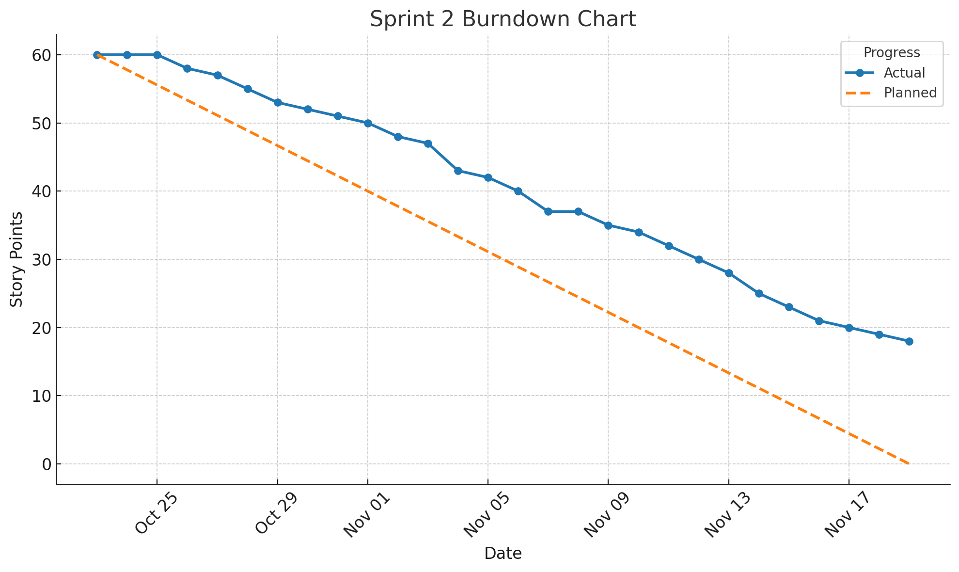
Burndown Chart - Sprint 2

Slide 42
Completed/Committed Ratio
Committed: 60 story points
Completed: 42 story points
Ratio: (42 / 60) * 100 = 70%

Slide 43
Completed/Committed Ratio - Average and Historical
Sprint 1: 100% completion (42 out of 42 points)
Sprint 2: 70% completion (42 out of 60 points)
Average Completed/Committed Ratio: (100 + 70) / 2 = 85%

Slide 44
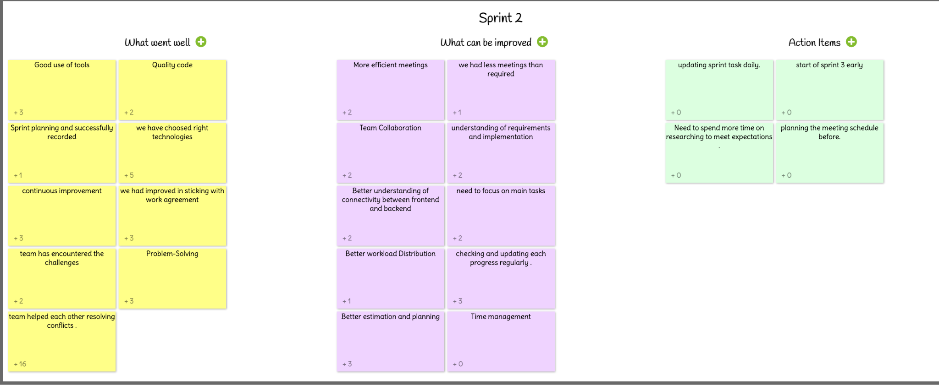
Retrospective

Slide 45
Sprint 3
# | Sprint | Story/Task | Story Points | Acceptance Criteria
1 | Sprint 3 | User Story 11: User Accounts & Syncing | 8 Points | Users can create accounts with email/password. User progress, preferences, and recommendations are saved and synced across devices.
2 | Sprint 3 | User Story 12: Adaptive Study Paths | 13 Points | The app uses ML to analyze long-term trends and dynamically adjust learning paths. Preferences are stored, and content is adapted based on user learning styles.
3 | Sprint 3 | User Story 13: Reminders for Spaced Repetition & Recommendations | 5 Points | Notifications prompt users for spaced repetition and recommended articles. Reminders are personalized based on past performance and study schedules.
4 | Sprint 3 | User Story 14: Learning History | 8 Points | Users can access their study history, including completed articles and quizzes. History includes quiz scores, article read dates, and time spent.
5 | Sprint 3 | User Story 15: Adaptive Feedback Based on Trends | 8 Points | The app provides adaptive feedback based on overall performance and trends. Feedback is more tailored as the system learns from the user’s progress and actions.

Slide 46
Sprint 3
# | Sprint | Story/Task | Story Points | Acceptance Criteria
6 | Sprint 3 | Technical Story 9: User Authentication | 3 Points | Secure user authentication system with account creation, login, and password recovery. Ensure user progress and data are stored across sessions.
7 | Sprint 3 | Technical Story 10: Refined ML for Long-Term Learning | 8 Points | The ML model adapts based on user learning patterns and feedback. Ensure the model evolves based on long-term trends and personalized learning data.
8 | Sprint 3 | Technical Story 11: Reminders & Notifications | 5 Points | Notifications are sent based on spaced repetition schedules and content recommendations. Ensure reminders are relevant and personalized to user learning paths.
9 | Sprint 3 | Technical Story 12: Final UI/UX Improvements | 3 Points | Refine the user interface for a smooth, intuitive experience. Ensure the app is fully responsive and accessible on different devices.
10 | Sprint 2 (Carryover) | User Story 9: Targeted Feedback on Quizzes | 5 Points | Detailed feedback is provided for each quiz question. Feedback explains why certain answers are correct/incorrect.

Slide 47
Sprint 3
# | Sprint | Story/Task | Story Points | Acceptance Criteria
11 | Sprint 2 (Carryover) | User Story 10: Dynamic Content Adjustment | 8 Points | The difficulty of content increases if the user performs well. If a student struggles, simpler articles or review content is recommended.
12 | Sprint 2 (Carryover) | Technical Story 8: Quiz Feedback Mechanism | 5 Points | Implement feedback mechanisms to explain quiz results. Feedback is both constructive and designed to reinforce learning.

Slide 48
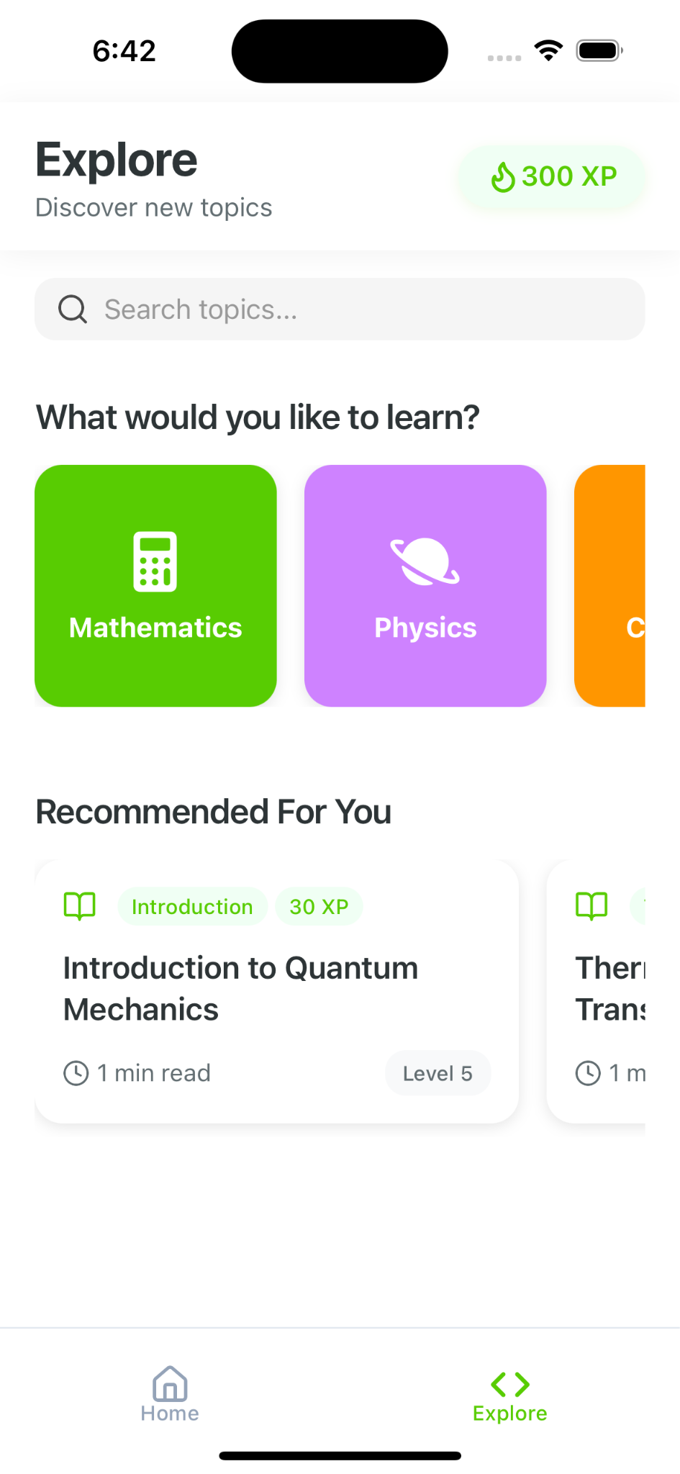
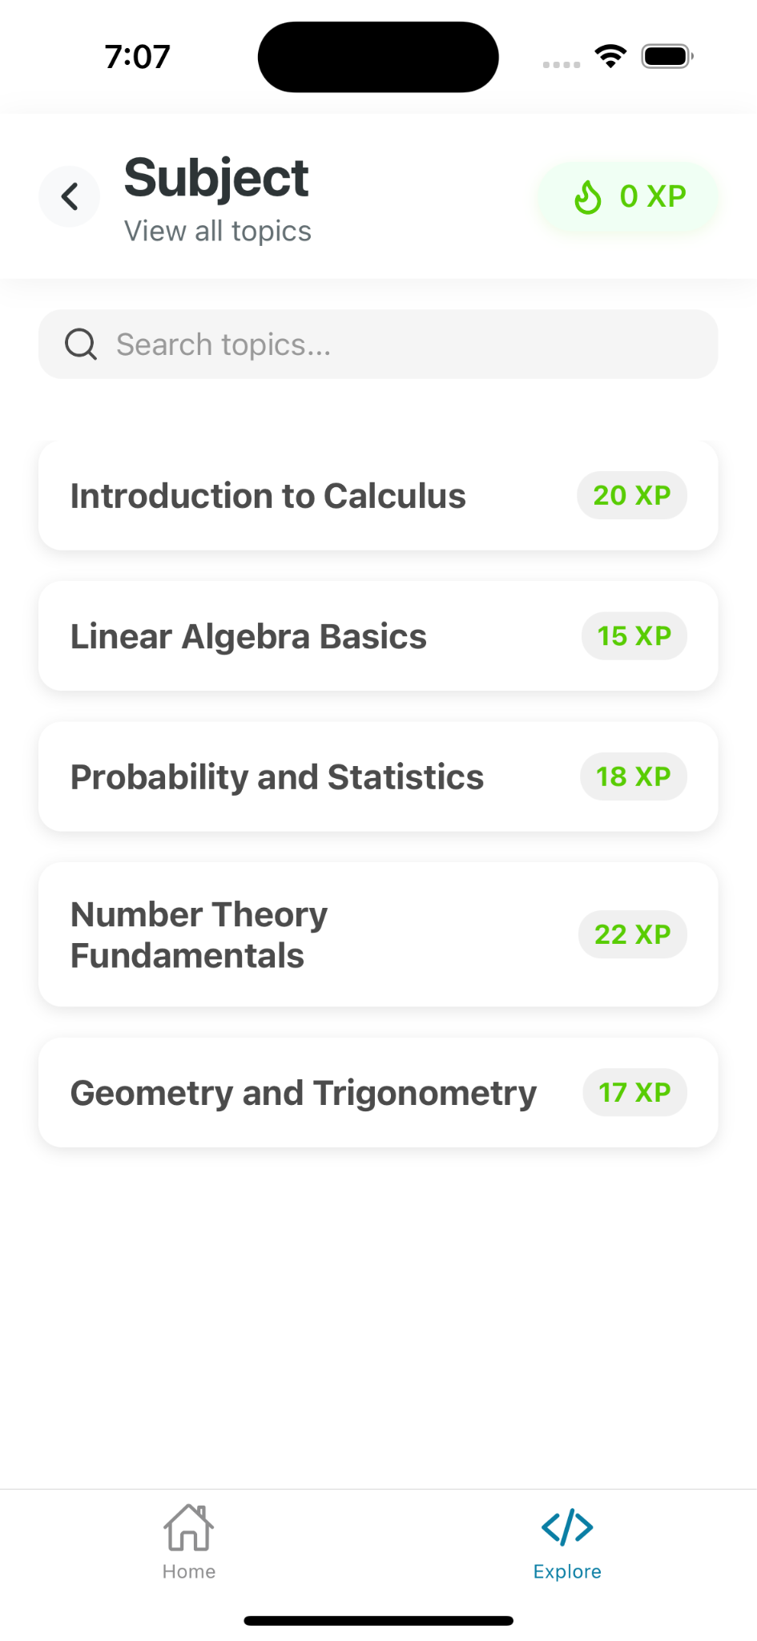
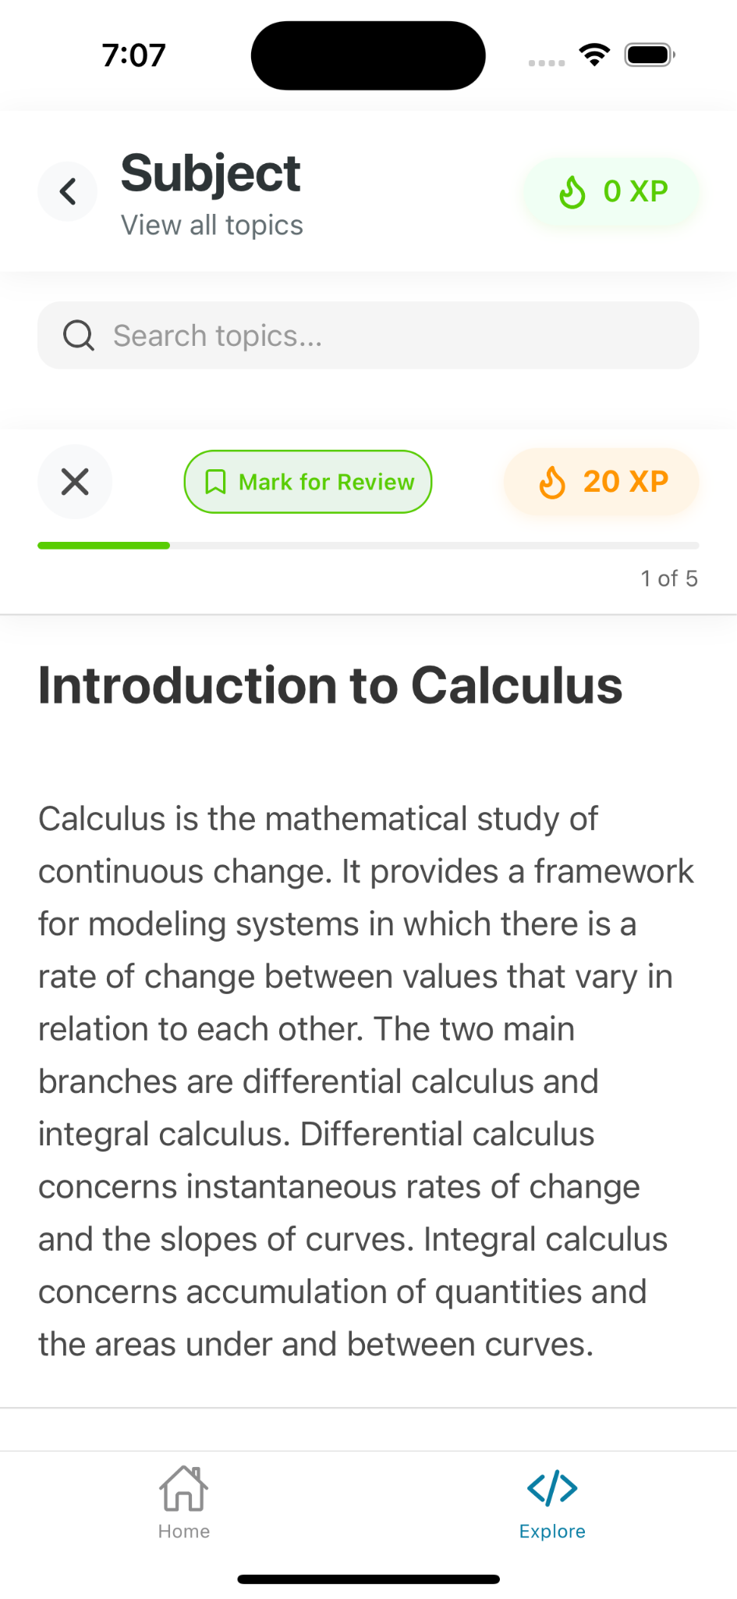
App Screenshots
Explore Screen
List of Lessons
Article screen

Slide 49
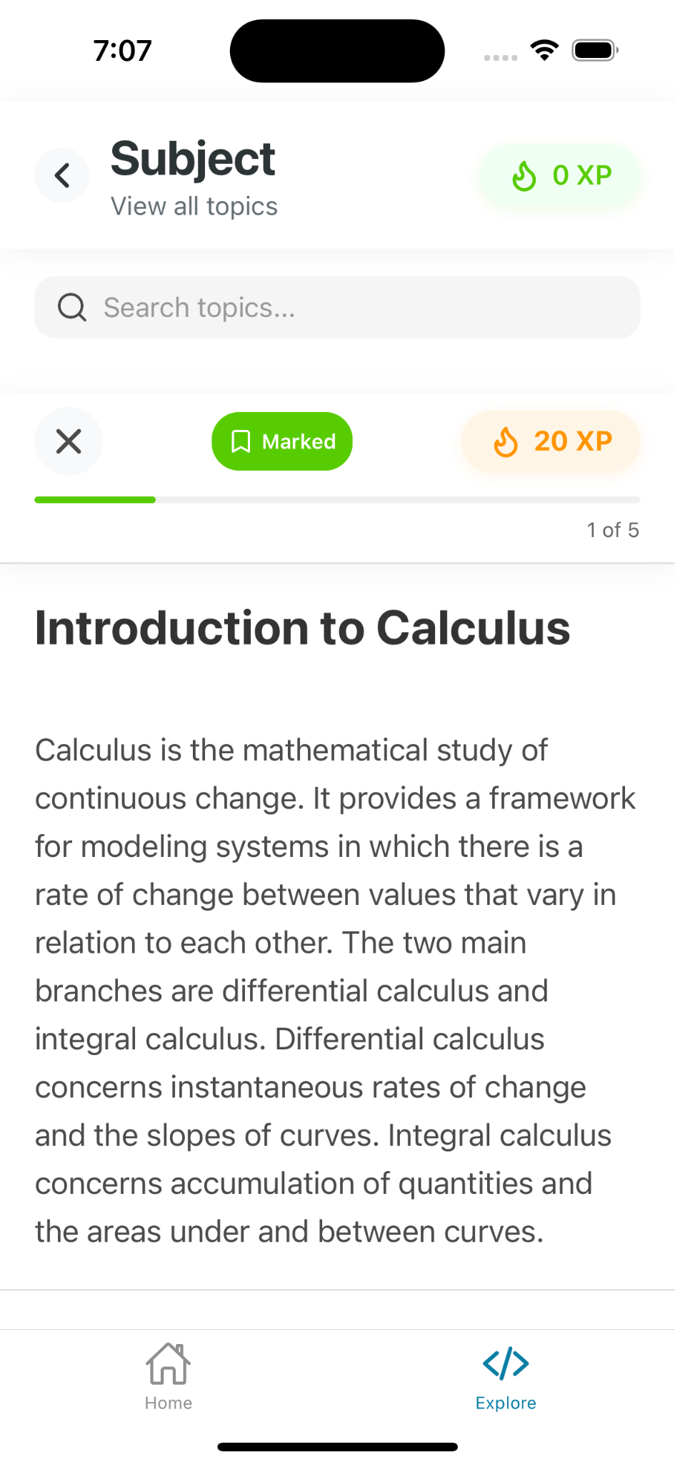
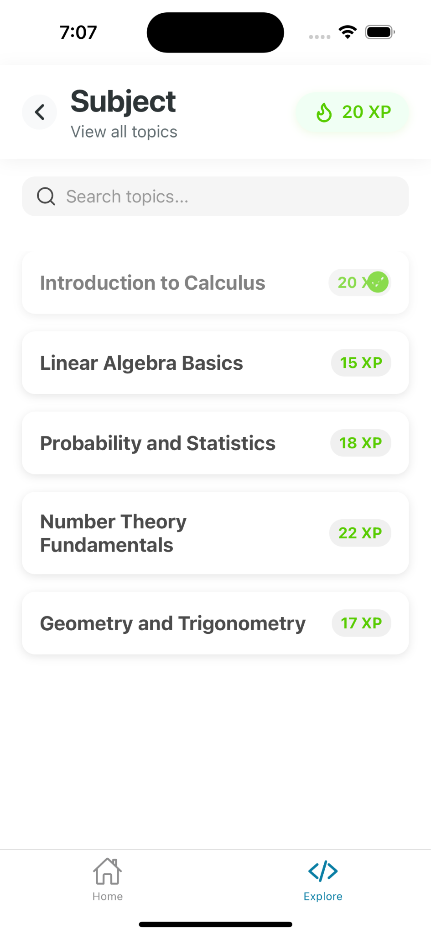
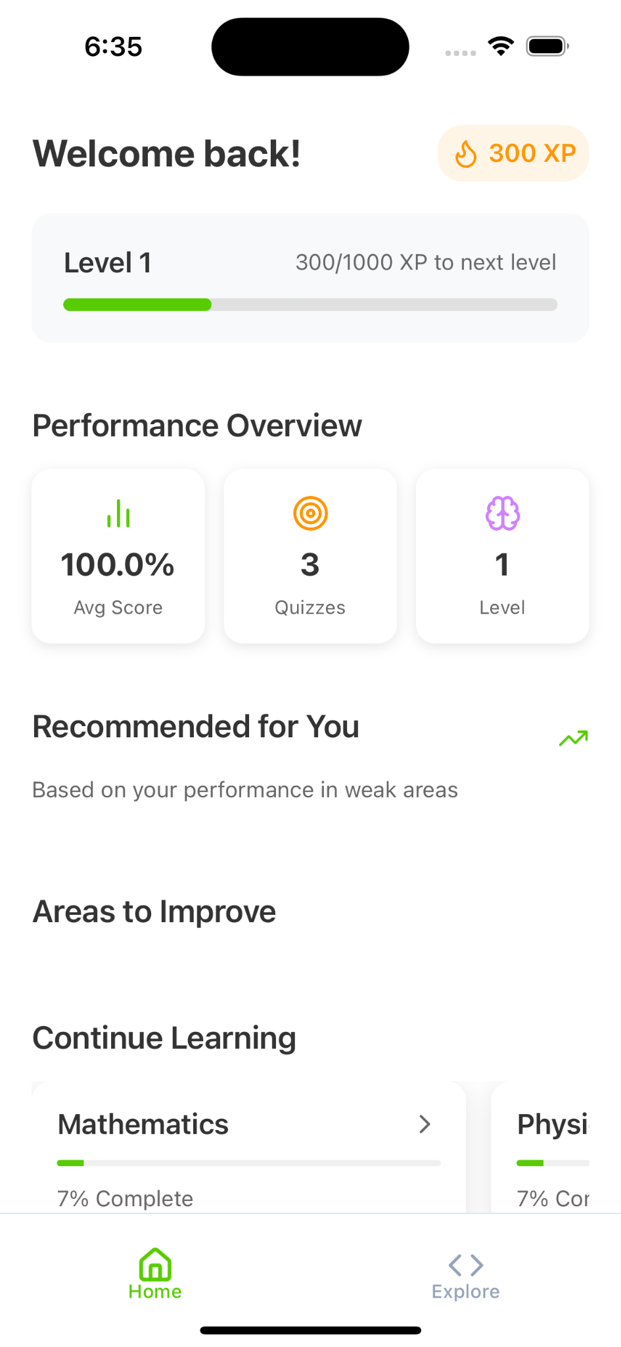
App Screenshots
When article is marketed to read later
When article is completed, adding of rewards
HomeScreen with dashboard

Slide 50
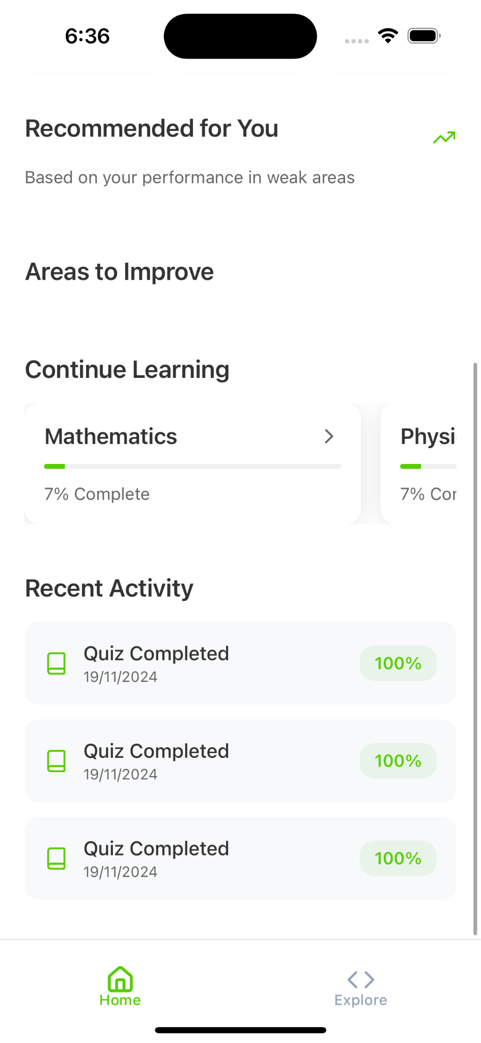
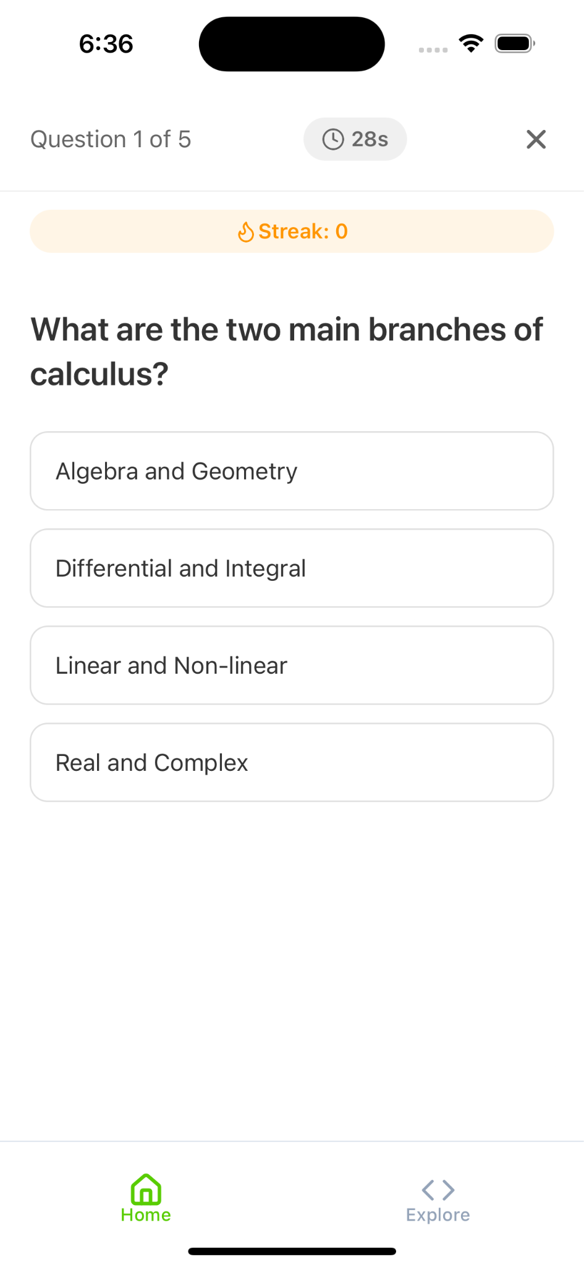
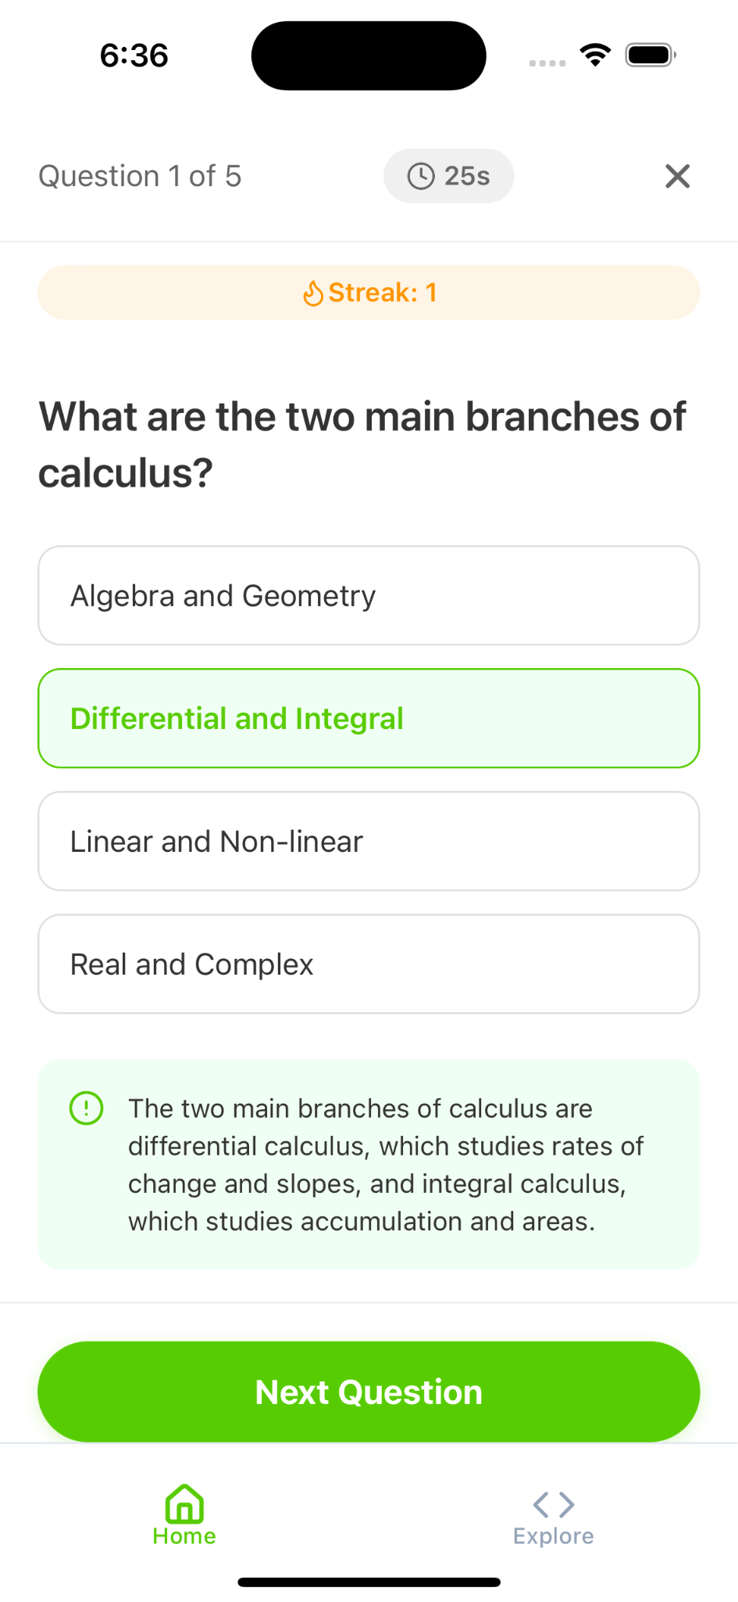
App Screenshots
Recent Activities
Quiz
When correct answer

Slide 51
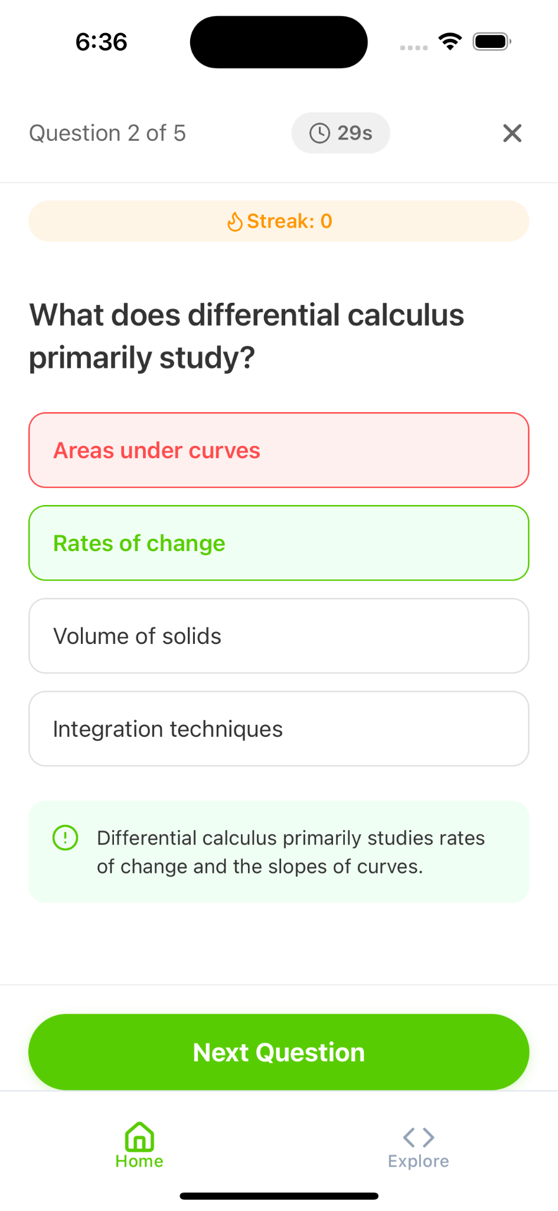
App Screenshots
When answered wrong

Slide 52
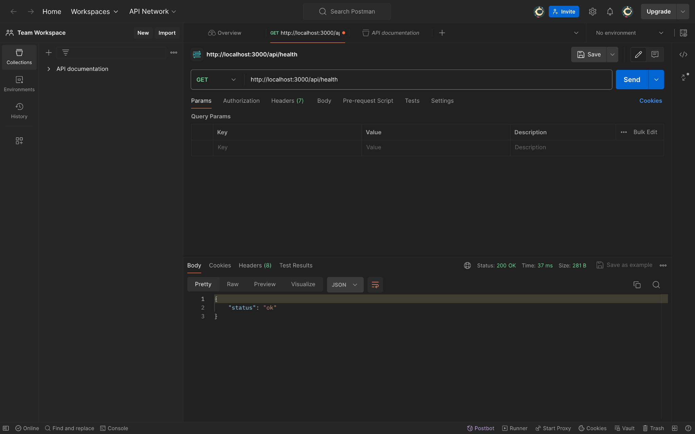
API

Slide 53
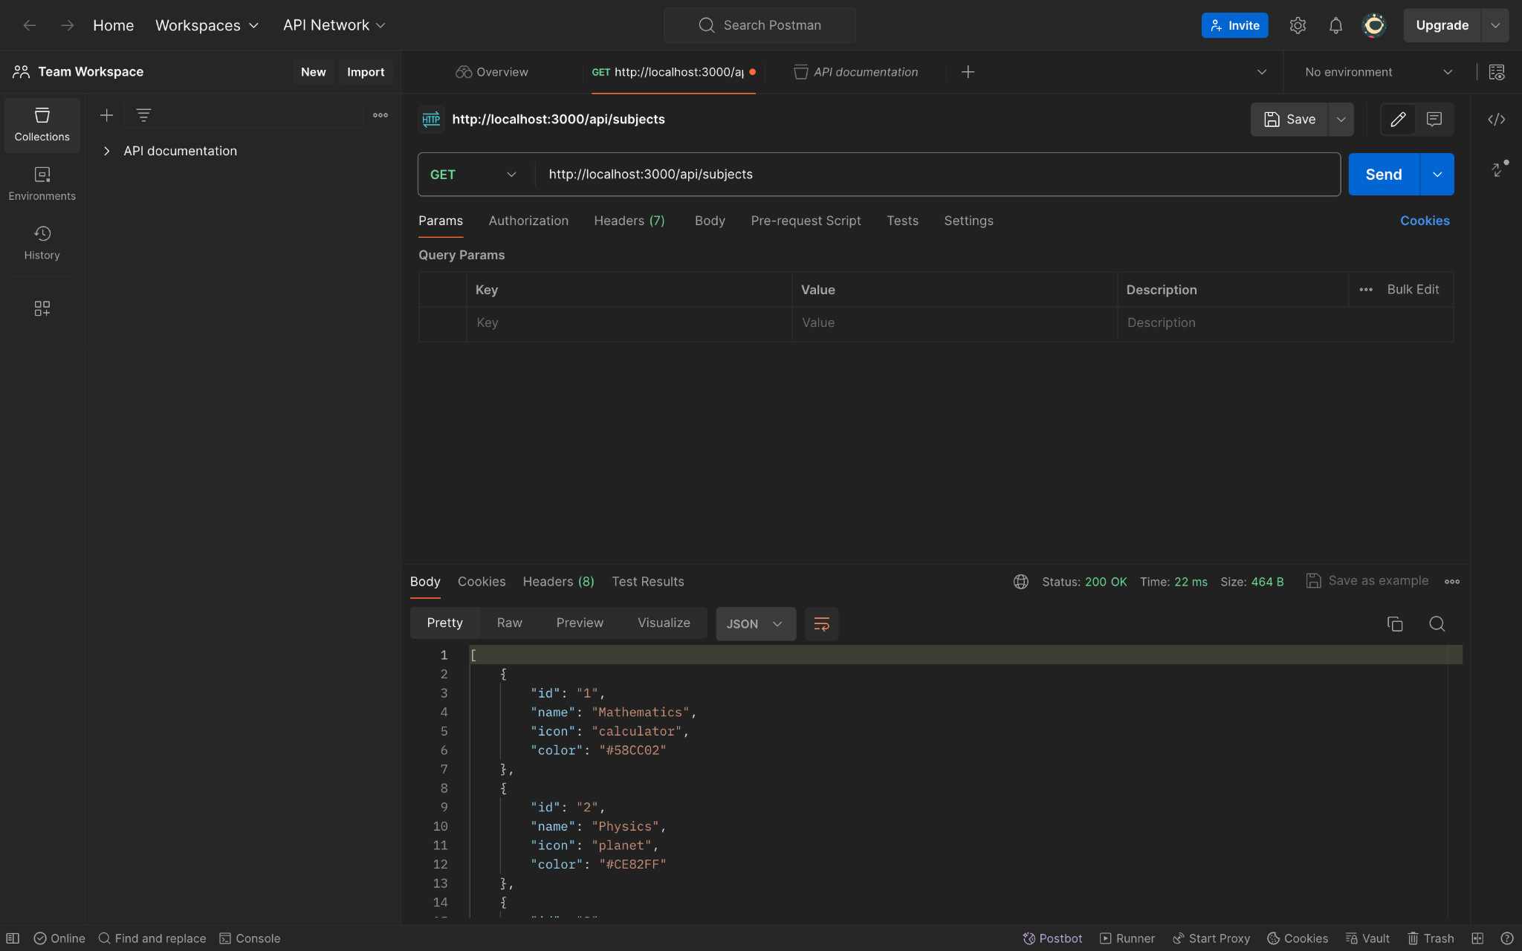
API

Slide 54
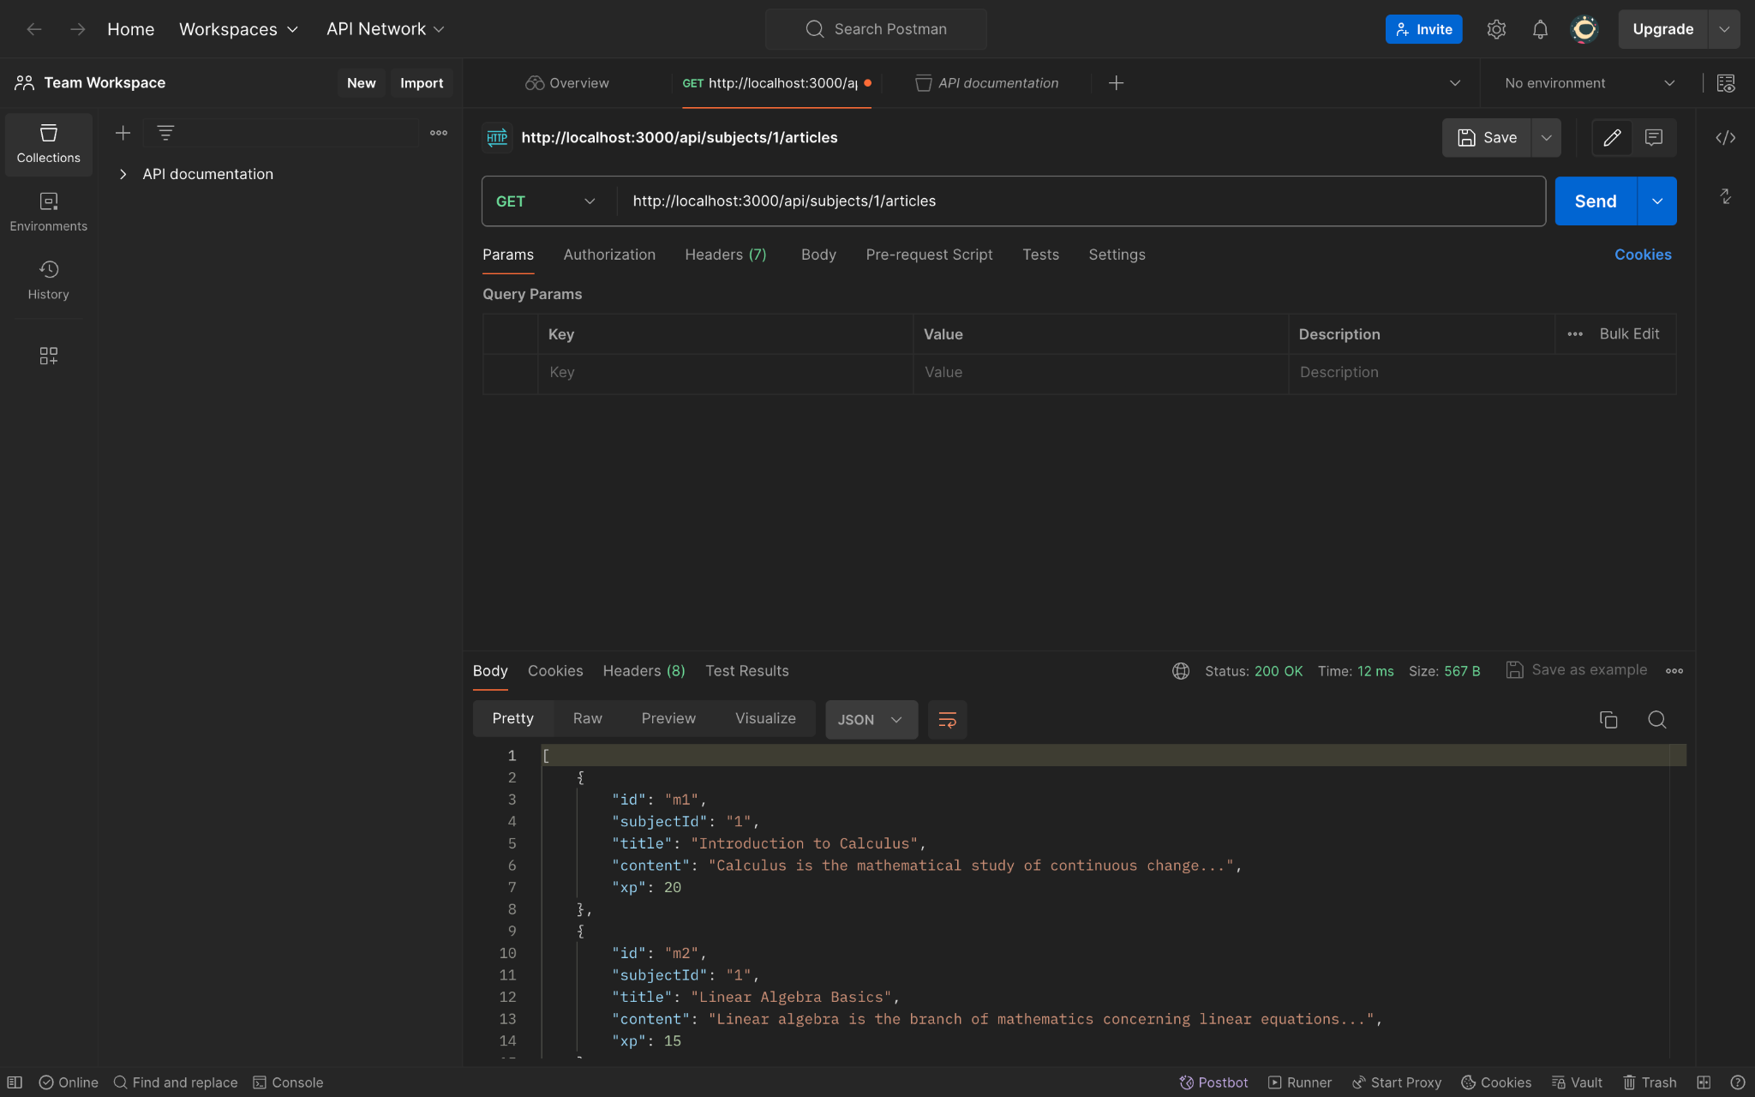
API

Slide 55

API

Slide 56
Wiki Link
https://github.com/htmw/2024F-Tech-Titans/wiki

Slide 57
Live Demo

